Slide 1
February 2023
The Regular Board Meeting will be on: February 8, 2023
Meeting Schedule & Calendar for 2023
Please call in case of a water or sewer emergency:
Chris Hiltunen
586-557-0822
Nick Jarskey
231-944-4621

Slide 2
COTTRELLVILLE TOWNSHIP CLEAN WATER STATE REVOLVING FUND LOAN APPLICATION (CWSRFL)
PROJECT PLAN CLICK HERE

Slide 3
Emterra Yard Waste
If you are interested in having your yard waste picked up, please call Emterra at 810-577-6195.
Emterra no longer sends out invoices to customers for this service.
There is a $125.00 fee per season that can be paid for over the phone using a credit or debit card.

Slide 4
Renew Dog Licenses online or at the following Cities or Townships!
The following City and Township Treasurers can now sell renewals for dog licenses to any dog owner who resides in St. Clair County. For renewals you must bring your dog’s current Rabies Certificate from a licensed veterinarian.
Cities: Marysville & Memphis
Townships: Berlin, Casco, Clay, Columbus, Grant, Greenwood, Mussey, Riley, and Wales.
For first time licensing of a new puppy or newly acquired dog, the owner must register their dog directly with St Clair County Animal Control.
For additional information please visit: http://stclaircounty.org/offices/animal_control
When remitting water bills and tax bills, please send separate checks.

Slide 5
Feel free to call the Clerk’s office during open hours if you have any questions regarding your water bills.
Water Billing
To sign up for
Automatic Payments:
CLICK HERE
Just a reminder: When moving or selling your home, please call for final water meter read.
810-765-4730

Slide 6
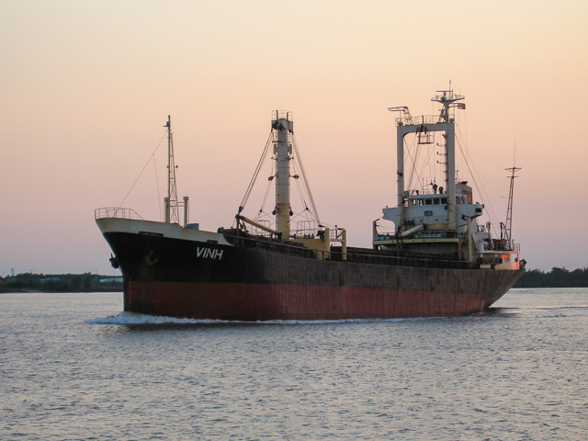
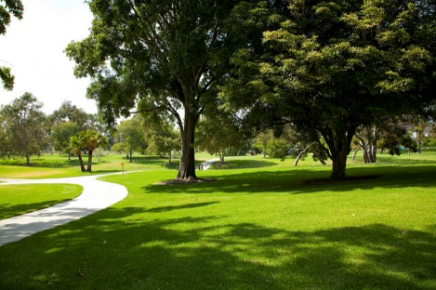
Cottrellville Township
5 Year
Master Plan
Cottrellville Township
5 Year
Parks & Recreation
Master Plan

Slide 7
Cottrellville Township’s Adopted Resolutions & Ordinances for 2016-2017
#R-2017-01 Right of Way
#R-2016-04 Delinquent Water Bills/Renter’s Deposit
#R-2016-02 Authorize Trial of Water & Sewer Billing by Clerk’s Office
Accessory Building Ordinance 132.1404
#R-2017-05 Change in Water Billing Due Date for Collection of Payments
#R-2017-06 Water Tap Fee Increase
#R-2017-03 Required Bidding for Contracts over $5,000
#R-2017-04 Policies & Procedures of the Township Office Hours
Cottrellville Twp. St. Clair County, MI Fire and Emergency Reimbursement
Ordinance No. 103.000

Slide 8
Message from Planning Commission Chairperson, Pat Runyon
FCC Complaint Form
If you are having problems with your phone services
(cell service included) and have communicated with your service provider to no avail and your provider has not resolved your issues. Please fill out a FCC Complaint Form that you can mail in individually. You can file a complaint on-line or call to file your complaint. https://consumercomplaints.fcc.gov
Federal Communications Commission 445 12th Street SW Washington, DC 20554
Phone: 1-888-225-5322 Videophone: 1-844-432-227
TTY: 1-888-835-5322 Fax: 1-866-418-0232

Slide 9
Michigan Public Service Commission
- From the Department of Licensing and Regulatory Affairs -
Customers who are unable to resolve their video/cable television complaints with their providers are recommended to file a complaint with the MPSC office. The video/cable webpage is: http://www.michigan.gov/mpsc/0,4639,7-159-49641---,00.html
The webpage includes information such as the complaint process, the Public Act 480 of 2006 and a current listing of active video/cable providers in Michigan.
The following link is to our Consumer Tips sheet: http://www.michigan.gov/documents/mpsc/video_cable_complaints_437708_7.pdf

